Slide 1

Chapter 1
Ten Principles of Economics
© 2002 by Nelson, a division of Thomson Canada Limited

Slide 2
In this chapter you will…
Learn that economics is about the allocation of scarce resources.
Examine some of the tradeoffs that people face.
Learn the meaning of opportunity cost.
See how to use marginal reasoning when making decisions.

Slide 3
In this chapter you will…
Discuss how incentives affect people’s behaviour.
Consider why trade among people or nations can be good for everyone.
Discuss why markets are a good, but not perfect, way to allocate resources.
Learn what determines some trends in the overall economy.

Slide 4
TEN PRINCIPLES OF ECONOMICS
Society and Scarce Resources:
The management of society’s resources is important because resources are scarce.
Scarcity. . . means that society has limited resources and therefore cannot produce all the goods and services people wish to have.

Slide 5
TEN PRINCIPLES OF ECONOMICS
Economics is the study of how society manages its scarce resources.
Economists study how people make decisions:
How much they work
What they buy
How much they save
How they invest their savings

Slide 6
TEN PRINCIPLES OF ECONOMICS
Economists also study how people interact such as buyers and sellers.
Price determination.
Economists also analyze forces and trends that affect the economy as a whole.
Growth in average income
The rate of price increase.

Slide 7
Principle 1: People Face Tradeoffs
“There is no such thing as a free lunch”
To get something we like we usually have to give up something we don’t like.
A student and her time:
Studying vs. napping or cycling.
Society’s tradeoffs:
Guns vs. Butter
Clean environment and higher income

Slide 8
Principle 1: People Face Tradeoffs
Society’s tradeoffs (cont’d):
Efficiency vs. Equity
Efficiency: Society getting the most it can from its scarce resources.
Equity: Distributing economic prosperity fairly among the members of society.

Slide 9
Principle 2: The Cost of Something is what You Give Up
Making decisions requires comparing the costs and benefits of alternative courses of actions.
To go to university or not to go?
Opportunity cost: Whatever must be given up to obtain some item.

Slide 10
Principle 3: Rational People Think at the Margin
Marginal changes: Small incremental adjustments to marginal changes.
Individuals and firms can make better decisions by thinking at the margin.
By comparing the marginal benefits (MB) with the associated marginal costs (MC) of a decision.

Slide 11
Principle 4: People Respond to Incentive
Marginal changes in costs or benefits motivate people to respond.
When the price of apples rise…
The decision to choose one alternative over another occurs when that alternative’s marginal benefits exceed its marginal costs!

Slide 12
HOW PEOPLE INTERACT
The first four principles discussed how individuals make decisions.
The next three principles concern how people interact with one another.

Slide 13
Principle 5: Trade can Make Everyone Better Off
People gain from their ability to trade with one another.
Competition results in gains from trading.
Trade allows people to specialize in what they do best.

Slide 14
Principle 6: Markets are Usually a Good Way to Organize Economic Activity
Market economy: An economy that allocates resources through the decentralized decisions of many firms and households as they interact in markets for goods and services.
Firms decide whom to hire and what to make.
Households decide which firms to work for and what to buy with their incomes.

Slide 15
Principle 6: Markets are Usually a Good Way to Organize Economic Activity
Market economy: An economy that allocates resources through the decentralized decisions of many firms and households as they interact in markets for goods and services.
Firms decide whom to hire and what to make.
Households decide which firms to work for and what to buy with their incomes.

Slide 16
Principle 7: Governments can Sometimes Improve Market Outcomes
When the invisible hand does not work.
Market failure: A solution in which a market left on its own fails to allocate resources efficiently.
Externality: The impact of one person’s actions on the well-being of a bystander.
Market power: The ability of a single economic actor (or small group of actors) to have a substantial influence on market prices.

Slide 17
HOW THE ECONOMY AS A WHOLE WORKS
The last three principles concern the workings of the economy as a whole.

Slide 18
Principle 8: A Country’s Standard of Living Depends on its Ability to Produce Goods and Services
Standard of Living may be measured in different ways (e.g. personal income or total market value of a nation’s production.)
Differences in standard of living between countries or even provinces is attributable to the productivity of the country or province.
Productivity: The amount of goods and services produced from each hour of a worker’s time.
Productivity => Standard of Living

Slide 19
Principle 9: Prices Rise when the Government Prints Too Much Money
In Germany…
In January 1921, a daily newspaper cost 0.30 marks.
In November 1922, the same paper cost 70 000 000 marks.
Inflation: An increase in the overall level of prices in the economy.
One cause of inflation is the growth in the quantity of money.
When the government creates large quantities of money, the value of the money falls.

Slide 20
Principle 10: Society Faces a Short-Run Tradeoff Between Inflation and Unemployment.
Phillips curve: A curve that shows the short-run tradeoff between inflation and unemployment.

Slide 21
Economic Models
Economists use models to simplify reality in order to improve our understanding of the world
Two of the most basic economic models include:
The Circular Flow Diagram
The Production Possibilities Frontier

Slide 22
Our First Model: The Circular-Flow Diagram
The circular-flow diagram is a visual model of the economy that shows how dollars flow through markets among households and firms.

Slide 23
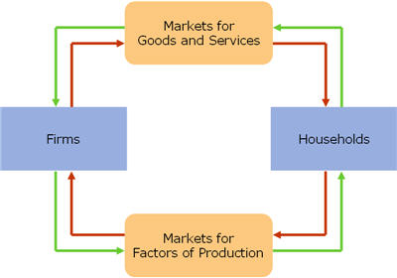
Diagram for Circular flow

Slide 24
The Circular flow
Firms
Produce and sell goods and services
Hire and use factors of production
Households
Buy and consume goods and services
Own and sell factors of production

Slide 25
The Circular Flow
Markets for Goods and Services
Firms sell
Households buy
Markets for Factors of Production
Households sell
Firms buy
Factors of Production
Inputs used to produce goods and services
Land, labour, and capital

Slide 26
Our second model: The production possibility frontier
The production possibilities frontier is a graph that shows the combinations of output that the economy can possibly produce given the available factors of production and the available production technology.

Slide 27
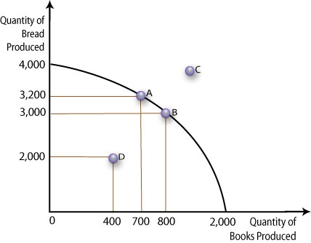
The production possibility frontier

Slide 28
Production Possibility Frontier
Point A: The country can produce 3,200 breads and 700 books.
Point B: The country can produce 3,000 breads and 800 books.
Point D: A point inside the curve indicates that the country is inefficient as they are not utilizing the resources properly.
Point C: Unattainable given the current resources, however achievable in the long run.

Slide 29
Our Second Model: The Production Possibilities Frontier
Concepts Illustrated by the Production Possibilities Frontier
Efficiency
Tradeoffs
Opportunity Cost
Economic Growth

Slide 30
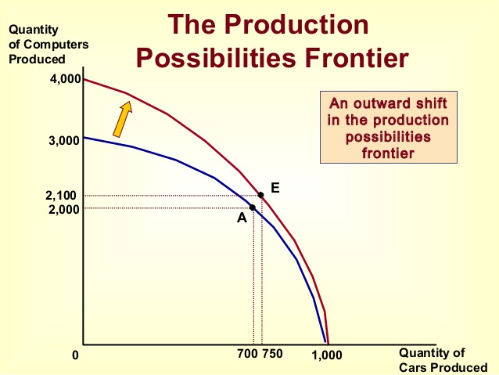
Shift in the Production Possibility Frontier

Slide 31
Shift in the Production Possibility Frontier
The two main determinants of the position of the PPF at any given time are the state of technology and management expertise and the available quantities of factors of production.
In the long run, if technology improves or if the supply of factors of production increases, the economy's capacity to produce both goods increases; if this potential is realized, economic growth occurs. And this increase is shown by a shift of the production-possibility frontier to the right.

Slide 32
Summary
When individuals make decisions, they face tradeoffs among alternative goals.
The cost of any action is measured in terms of foregone opportunities.
Rational people make decisions by comparing marginal costs and marginal benefits.
People change their behavior in response to the incentives they face.

Slide 33
Summary
Trade can be mutually beneficial.
Markets are usually a good way of coordinating trade among people.
Government can potentially improve market outcomes if there is some market failure or if the market outcome is inequitable.
Productivity is the ultimate source of living standards.

Slide 34
Summary
Money growth is the ultimate source of inflation.
Society faces a short-run tradeoff between inflation and unemployment.

Slide 35
The End

